Slide 1
Open Source
Project Communities
Prof. Dr. Dirk Riehle
Friedrich-Alexander University Erlangen-Nürnberg
FOSS B04
Notes:
It is Friedrich-Alexander University Erlangen-Nürnberg – FAU, in short.
Corporate identity wants us to say “Friedrich-Alexander University”.

Slide 2
Open Source Innovation
Legal innovation
Process innovation
Software tool innovation
Business model innovation

Slide 3
Open Source Process Innovation
Project communities
Engineering processes

Slide 4
Community Open Source Project
Project is owned and managed by community
  The project typically has only one license
  The governing body has no direct commercial interests
  No single vendor has undue / dominant influence

Slide 5
The Onion Model [CH11]
1. Reader
2. Passive user
3. Bug reporter
4. Bug fixer
5. Peripheral developer
6. Active developer
7. Core member
8. Project leader
User
Contributor
Committer

Slide 6
The Basic Career Path [R15a]
Has commit (write) rights
Performs bulk of the work, patch review
Committer
explicit promotion
Provides small features, bug fixes
Submits patches (no commit right)
Contributor
implicit promotion
Knows and uses software
If so, helps with comments, feedback
User

Slide 7
The Extended Career Path (Foundations)
Has interest of foundation at heart
Acts as coach, markets, represents
Foundation
Member
explicit promotion
Leads project management committee
Steers industry platform
PMC Leader
explicit promotion
Contributes to project management
Helps steer industry platform
PMC Member
from committer

Slide 8
The Full Open Source Career Path
Committer
Foundation
Member
explicit promotion
explicit promotion
Contributor
PMC Leader
implicit promotion
explicit promotion
User
PMC Member

Slide 9
The Apache Way 1 / 2 [A10b] (Official)
Collaborative software development
Commercial-friendly standard license
Consistently high quality software
Respectful, honest, technical-based interaction
Faithful implementation of standards
Security as a mandatory feature

Slide 10
The Apache Way 2 / 2 [C17] (Curcuru)
Charity
  Apache’s mission is providing software for the public good
Community
  Many of us are more effective than all of us
Consensus
  Getting good enough consensus is often better than voting
Merit
  Those that have proven they can do, get to do more
Open
  Technical decisions are discussed, decided, and archived publicly
Pragmatic
  Apache projects use the broadly permissive Apache license

Slide 11
The 3-4-5 Model of Project Communities
Three principles open collaboration
Four practices of open communication
Five stages of project volunteering

Slide 12
The Three Principles of Open Collaboration
Egalitarian participation
Meritocratic decision-making
Self-organizing processes

Slide 13
Principles in Comparison [R+09]
Traditional Work
  Hierarchical project assignment
    Closed and hidden silos
    Assigned to project
  Status-oriented decision making
    Public + private discussions
    Hierarchical status decides
  Predefined processes
    Prescribed process
    Prescribed jobs
Open Collaboration
  Egalitarian participation
    Open for contribution
    Everyone can contribute
  Meritocratic decision-making
    Public discussion process
    Decisions based on merit
  Self-organizing processes
    People find their process
    People find their project

Slide 14
The Four Practices of Open Communication
Public
Written
Complete
Archived

Slide 15
Public Communication 1 / 4
Public communication
  Is visible to everyone
  Creates trust and credibility
  Does not a priori exclude anyone
Almost all communication should be public
  Tools: mailing lists, forums, wikis, etc.
  Avoid private emails, phone conversations
  Summarize private discussions using email

Slide 16
Written Communication 2 / 4
Written communication
  Increases the reach of communication
  Reduces barriers to participation (time and location)
  Supports archiving of discussions
(Almost) all communication should be in written form
  Creates transparency, traceability, history
  Reduces barriers to communication
  Makes it easier to gain volunteers
“If it wasn't written down, it might as well not exist.” [F05]

Slide 17
Complete Communication 3 / 4
Complete communication
  Increases effectiveness of communication
  Supports the on-boarding process
  Creates more trust, credibility

Slide 18
Archived Communication 4 / 4
Archived communication
  Simplifies documentation
  Supports on-boarding process
  Creates yet more trust, credibility

Slide 19
Project Immigration [B11]
User
  Needs to get a job done
  Searches web for software
  Finds a matching project
  Checks out the project
  Gives it a try; is happy
  Finds a bug; reports it
  Helps replicate bug; triage
  Engages in conversation
  Helps other users
  Contributes to docs
  Leads project
Developer
  Needs to solve a problem
  Searches web for software
  Finds a matching project
  Checks out the project
  Gives it a try; is happy
  Finds a bug; reports it
  Fixes bug; submits patch
  Engages in conversation
  Keeps finding + fixing bugs
  Receives commit rights
  Leads project

Slide 20
The Five Stages of Volunteering [R15b]
# | Volunteer View | Project View
1 | Find project | Market project
2 | Understand project | Explain project
3 | Engage with project | Engage with volunteer
4 | Work within project | Work with contributor
5 | Lead project | Enable career

Slide 21
Definition of Best Practice
A best practice is a broadly-accepted, often informally-defined method for achieving a specific goal. (Cf. State-of-the-art.) [DR]
Best practices in this presentation are marked as a reference if they were derived from related work. My interpretation typically evolved the original practice, though.

Slide 22
#1 Volunteer: Find Project
Stumble (and find)
  Stumble upon project
  Listen to word-of-mouth
Search (to find)
  Use general search engine
  Search on open source portal

Slide 23
#1 Project: Market Project 1 / 2
Active outreach [F05]
  Choose a good project name
  Define all relevant channels
  Use channels consistently
  Announce visibly
  Be matter of fact

Slide 24
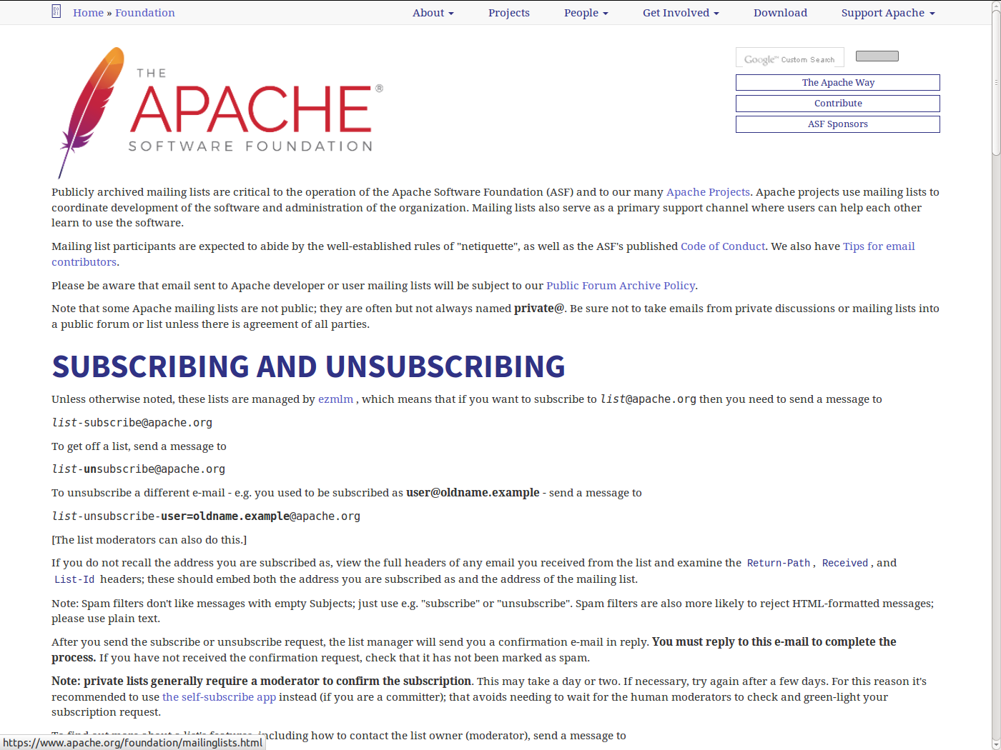
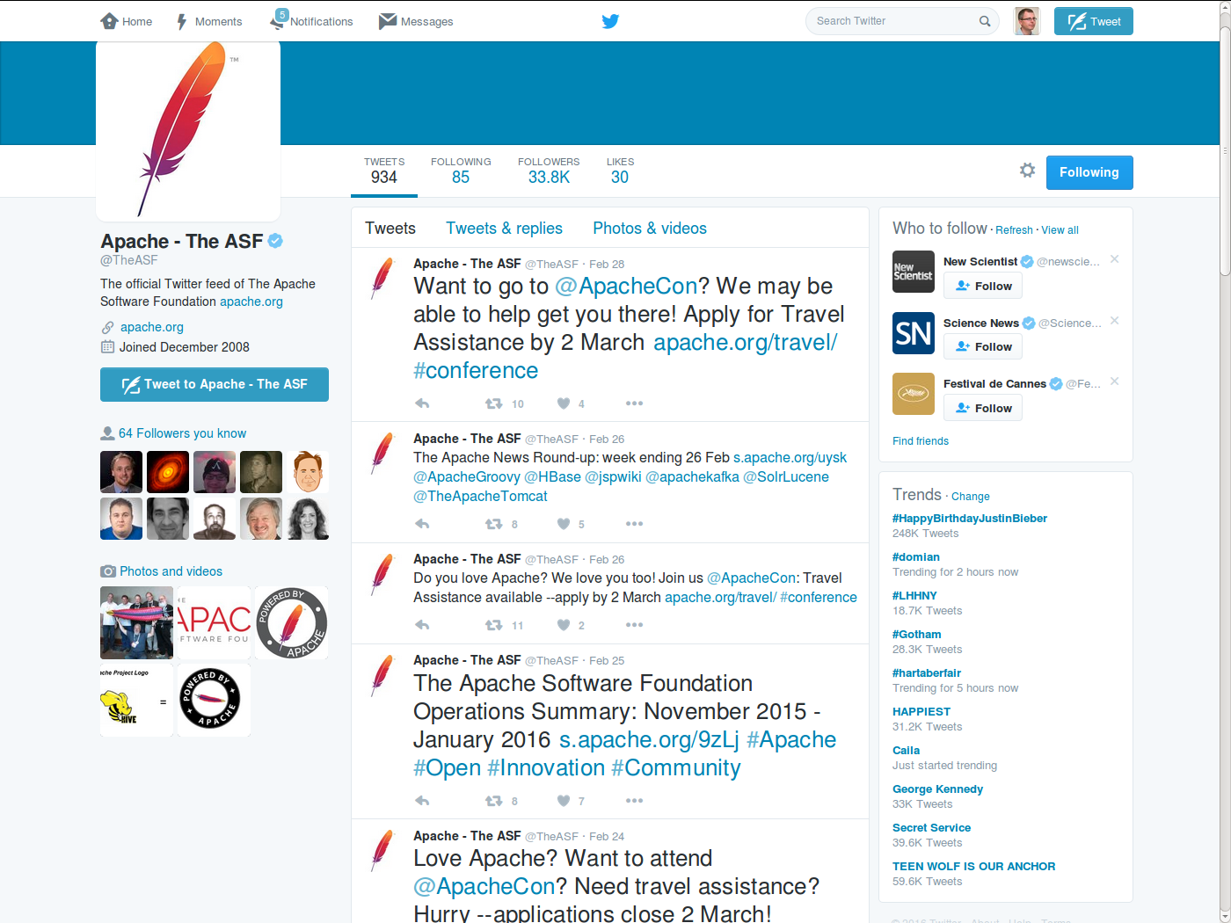
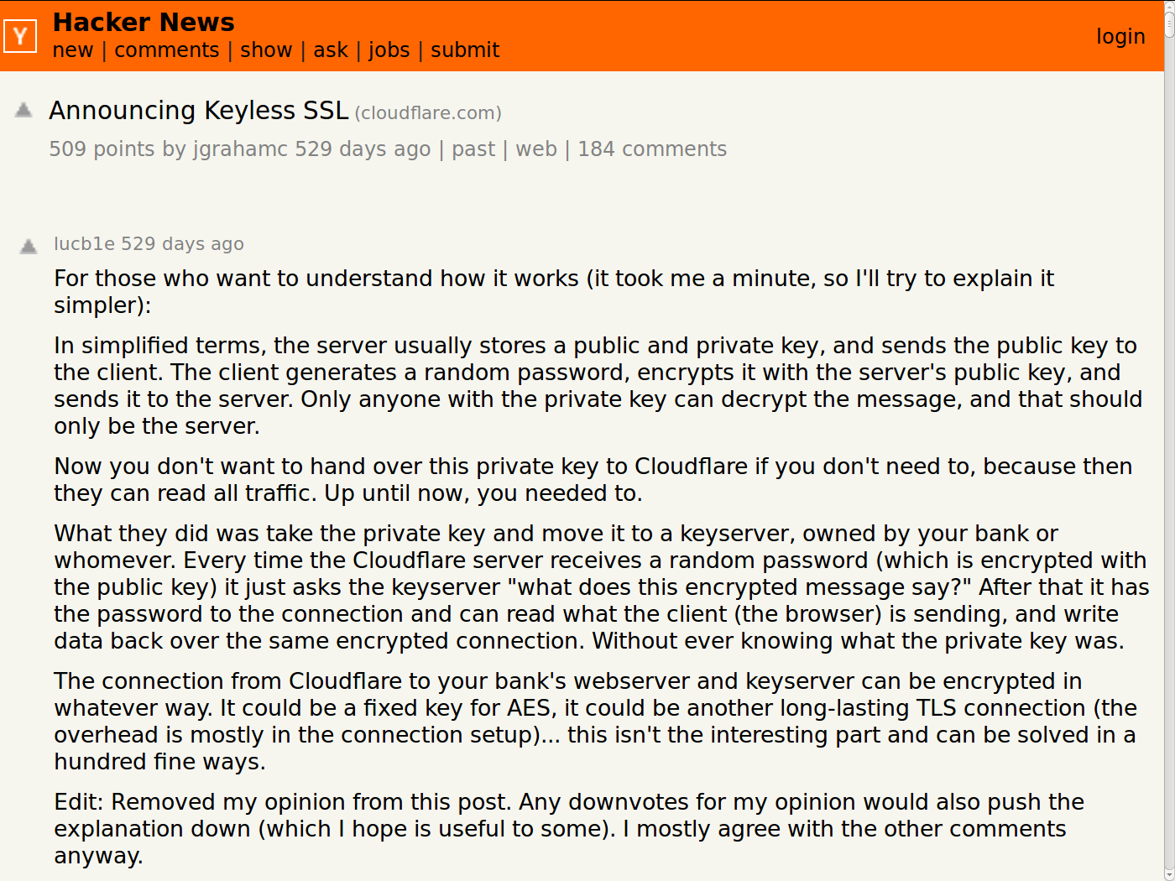
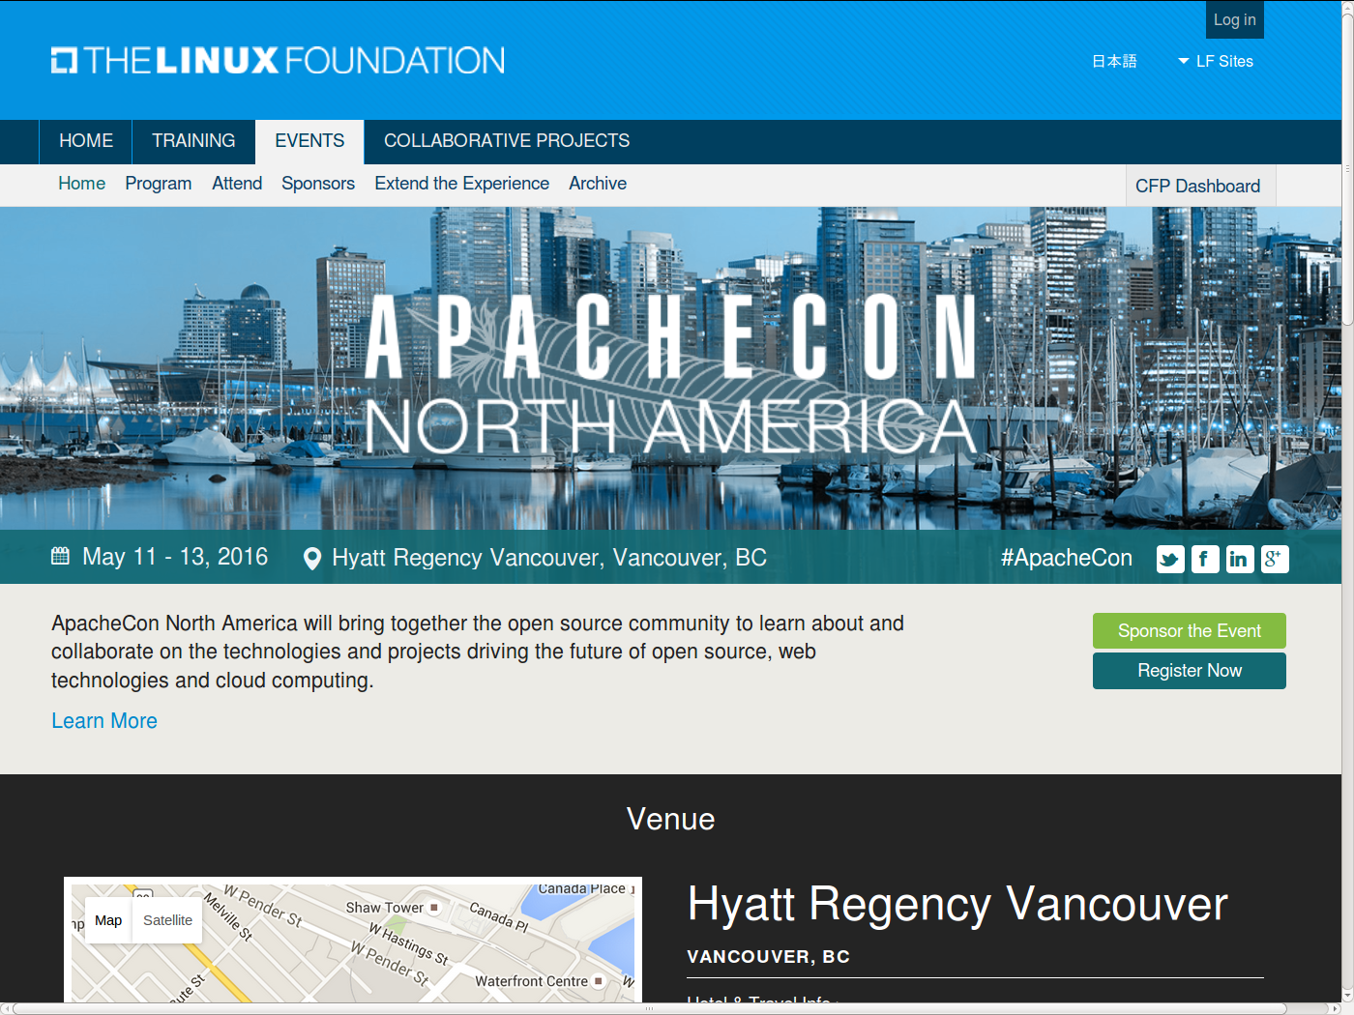

Slide 25
#1 Project: Market Project 2 / 2
Passive inflow
  Register on all relevant places
  Support search engines
  Support lucky chance
  Use open source portal features
  Provide findable summaries
  Work to support portal metrics

Slide 26
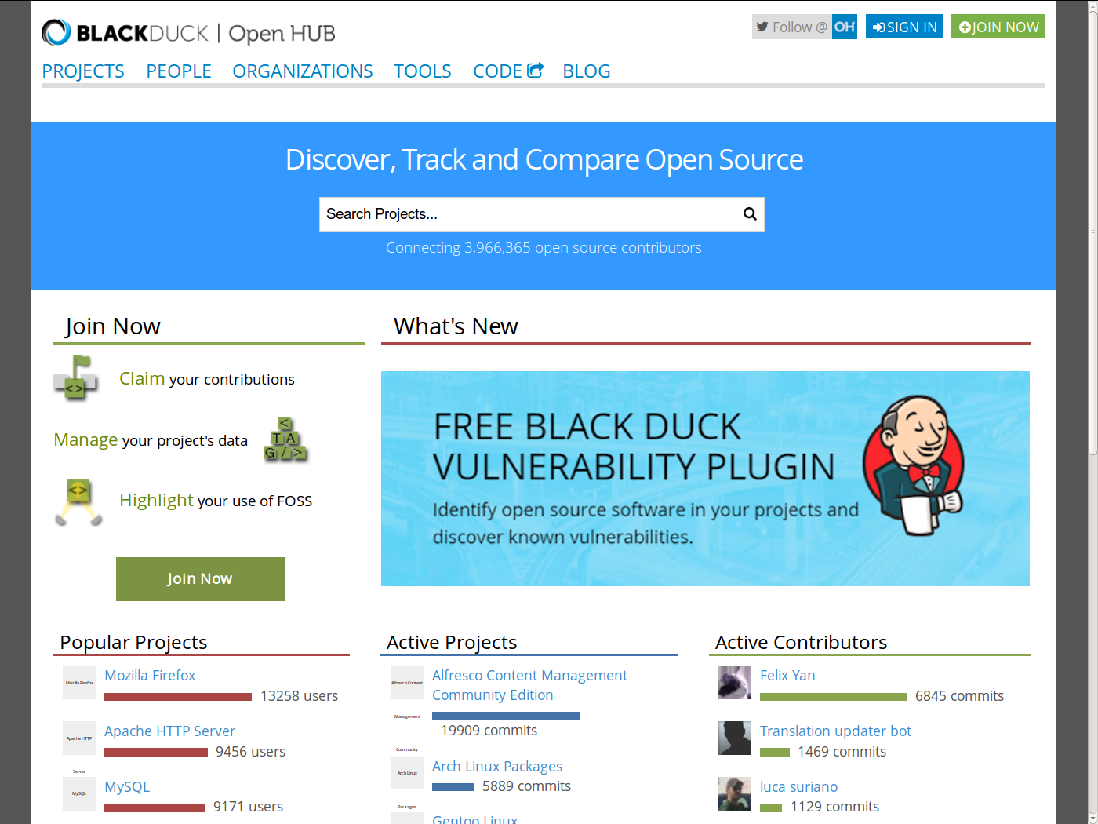
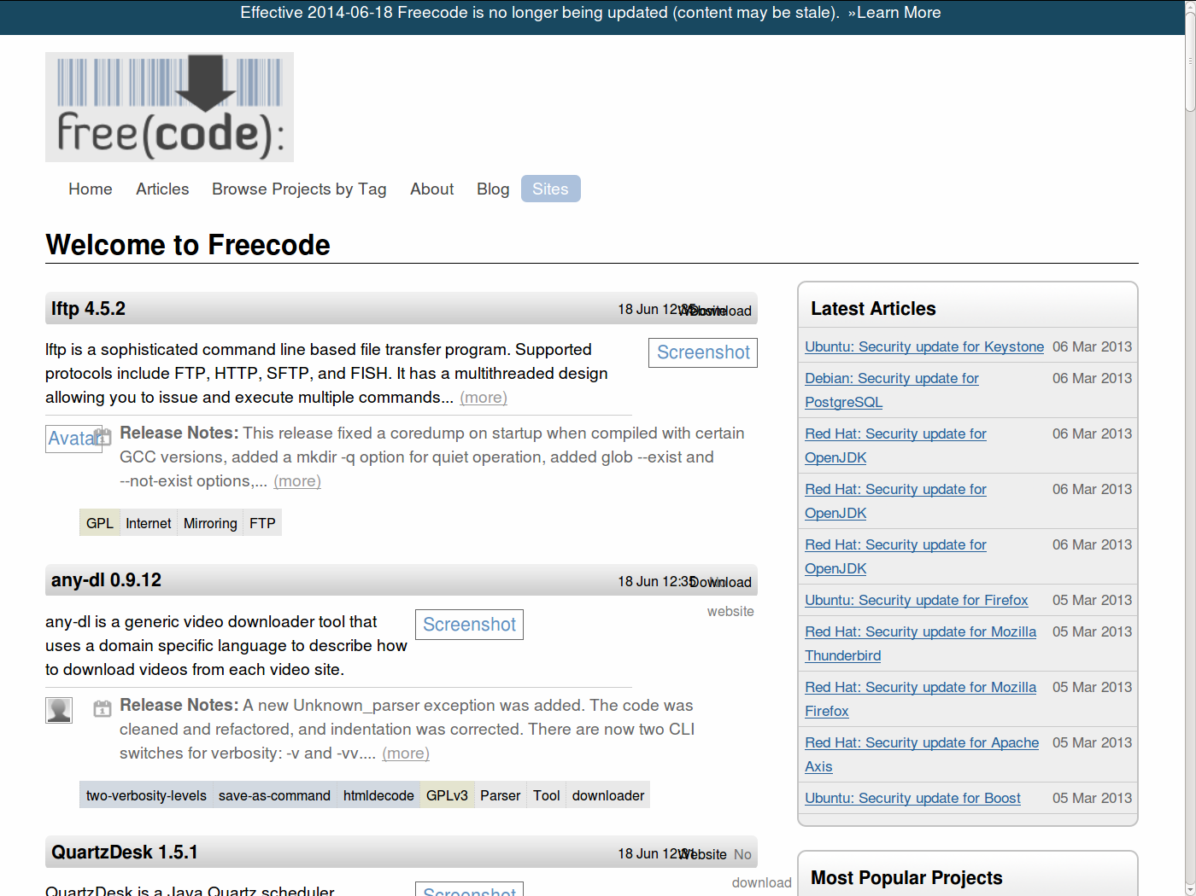
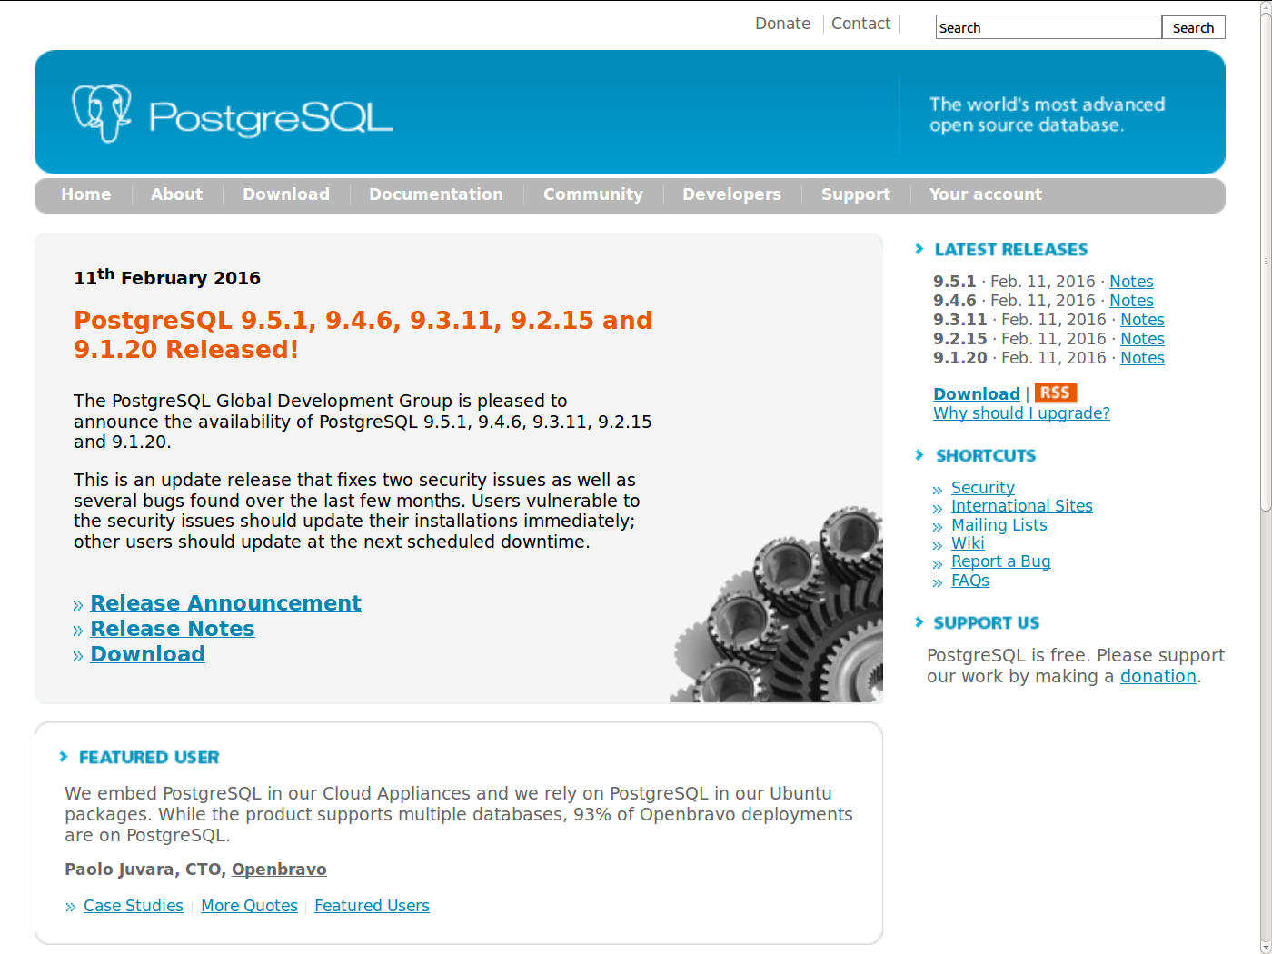
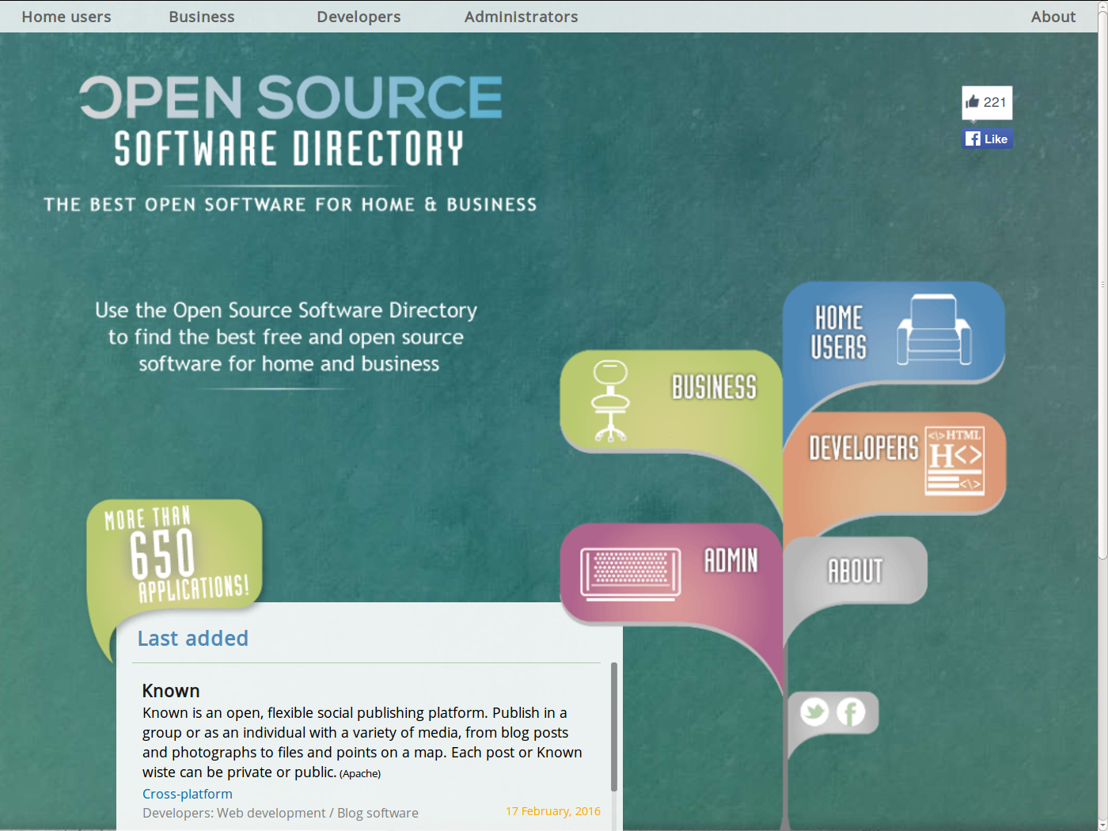

Slide 27
#2 Volunteer: Understand Project
Read up on project

Slide 28
#2 Project: Explain Project [F05]
Have clear mission statement
Provide examples and screenshots
State license and terms
Provide simple downloads
Show current and future features
Show development status
Provide user documentation
State whether volunteers are welcome
State rules of engagement

Slide 29
#3 Volunteer: Engage with Project 1 / 2 [B11]
(Volunteer) users
  Do your homework first
    Search archives
    Read documentation
  Communicate prudently
    Be matter of fact
    Don't jump to conclusions

Slide 30
#3 Volunteer: Engage with Project 2 / 2 [B11]
(Volunteer) developers
  Respect project practices
  Respect project culture
  Accept guidance

Slide 31
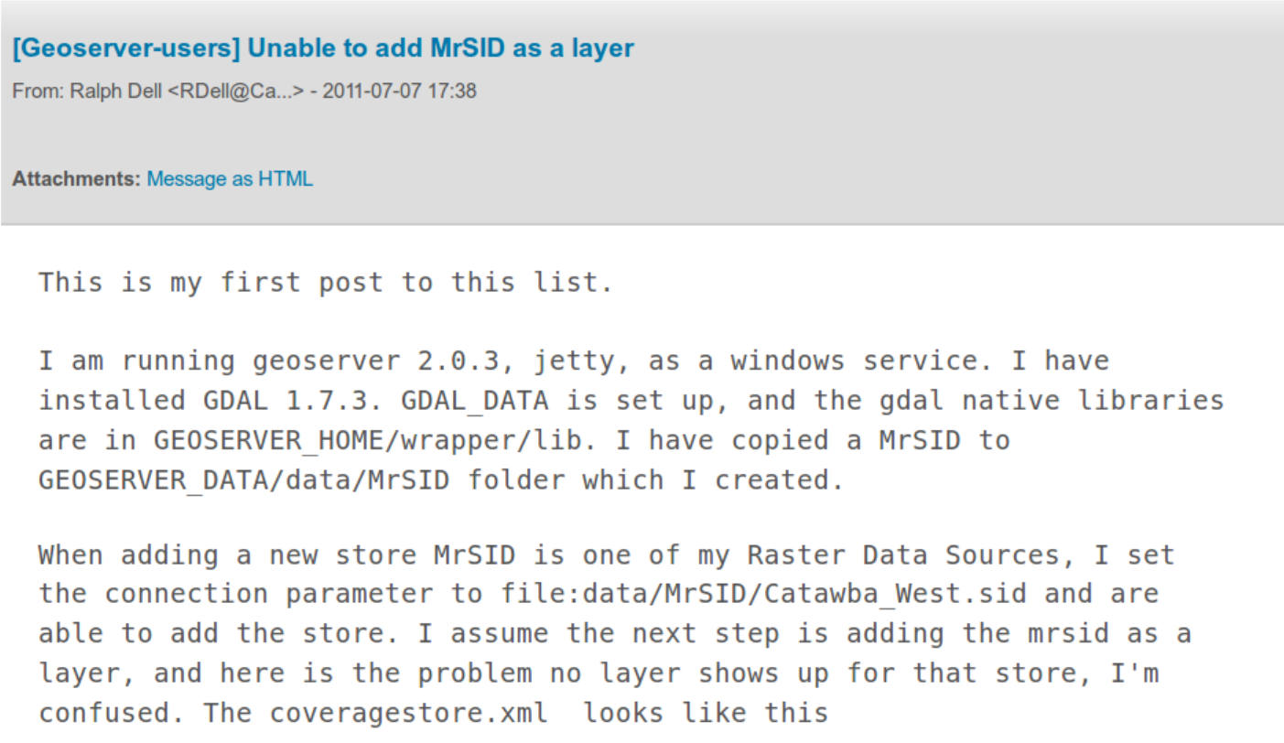

Slide 32
How to Ask a Question 1 / 2
The “simple” way [L11]
  I would like to do X (but it doesn’t work)
  I have tried Y to achieve X
  Then Z happened
Additional information
  configuration
  version information
Preferably no attachments
Short email (30 lines)

Slide 33
How to Ask a Question 2 / 2
The “smart” way [RM14]
  Choose your forum carefully
  Stack Overflow
  Web and IRC forums
  As a second step, use project mailing lists
  Use meaningful, specific subject headers
  Make it easy to reply
  Write in clear, grammatical, correctly-spelled language
  Send questions in accessible, standard formats
  Be precise and informative about your problem
  Volume is not precision
  Don't rush to claim that you have found a bug
  Groveling is not a substitute for doing your homework
  Describe the problem's symptoms, not your guesses
  Describe your problem's symptoms in chronological order
  Describe the goal, not the step
  Don't ask people to reply by private e-mail
  Be explicit about your question
  When asking about code
  Don't post homework questions
  Prune pointless queries
  Don't flag your question as “Urgent”, even if it is for you
  Courtesy never hurts, and sometimes helps
  Follow up with a brief note on the solution

Slide 34
Basics of Email Communication
OpenStack mailing list etiquette [O15]
  Subjects
  Formatting
  Netiquette

Slide 35
Effective Written Communication
Every (email) contribution should have one purpose
  Open a new issue that needs discussion
  Support or argue against the issue at hand
  Conclude discussion and summarize for archiving
Follow patterns of effective writing
  72 characters, use subject line, use real sentences
  Assume good faith, make no assumptions, use neutral tone
  Terseness is acceptable, rudeness is not
  Use URLs for reference, shortening
Use the correct tool for the purpose
  For example, no discussions in the bug tracker

Slide 36
Archive as Public Documentation
Reasons for public documentation of project
  Public documentation creates transparency, credibility, trust
  Credibility and trust helps get volunteer contribution
  Good public documentation reduces work, supports scaling up
Public documentation needs to be backed into process
  Mailing lists should have publicly readable archive
  Wiki should be crosslinked with mailing list, bug tracker, code repository
  Documentation work should be publicly recognized as valuable
What to document? Anything of value to the project

Slide 37
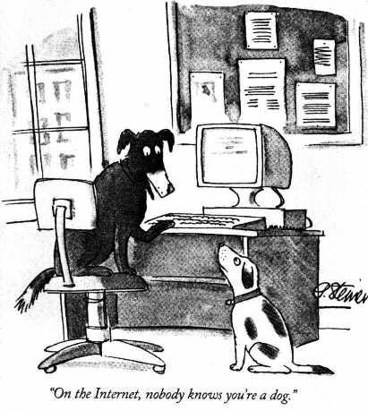
Social Aspects of Communication [CF08]
Be consistent in your communication
  Adopt a real/serious name
  Use that name consistently
  Don't self-aggrandize
  Use proper language
Show no tolerance against rudeness
  Rudeness destroys communities
  Separate rudeness from content
Companies have training programs

Slide 38
Advice on Email Communication
Sue Gardner on Wiki[p/m]edia communications [G16]
  “You are going to be doing a lot of writing. Do it well.”
  “In all your communications, be conscious of your group’s diversity.”
  “Be cautious about creating an insider culture.”
  “Publish early, publish often.”
  “Be aware that volunteer time is different from paid time.”
  “Write (and publish) a greater volume of stuff than you think you should.”
  “Assume good faith.”
  “Bias towards transparency. Way, way, way more than you think you should.”
  “When you change your mind, say it publicly, and explain why.”
  “Pay attention to people you disagree with.”

Slide 39
#3 Project: Engage with Volunteer 1 / 2 [F05]
(Engage) with everyone
  Show how to reach you
  Welcome people to community
  Stop any rudeness
  Avoid private discussions
  Accept initial redundancy
  Provide simple tasks

Slide 40
#3 Project: Engage with Volunteer 2 / 2 [F05]
(Engage) with developers
  Provide tool access
  Show requirements list
  Provide developer guidelines
  Provide developer docs

Slide 41
What Motivates Volunteers?
Technical Motivation
  To solve their technical problem
Economic Motivation
  To signal their capabilities to the labor market
  To achieve status of economic value
Social Motivation
  To feel validated by other people
  To enjoy a community
  To do good

Slide 42
Getting to the First Contribution
Make first contribution easy
Make contributions incremental
Remove arbitrary tool obstacles
Call out lurkers from shadows

Slide 43
#4 Volunteer: Work within Project
Be responsive
Be reliable
Contribute

Slide 44
#4 Project: Work with Contributor 1 / 3 [F05]
General practices
  Be component-oriented
  Work from features
  No discussions in bug tracker

Slide 45
#4 Project: Work with Contributor 2 / 3 [F05]
Working with a new contributor
  React speedily, don't sit on patches
  Turn contributions into conversations
  Practice conspicuous code review
  Track contributions, provide credit
  Praise plentiful, criticize specifically
  Prevent territoriality

Slide 46
#4 Project: Work with Contributor 3 / 3 [F05]
Working with a regular contributor
  Track volunteer interests, assign accordingly
  Distinguish inquiry from assignment
  Share technical as well as managerial tasks
  Follow-up to delegated assignment
  Document practices and traditions
  Archive practice descriptions

Slide 47
Meritocratic Decision Making Process
Process for decision making depends on the project
  Compare Linux Kernel vs. PostgreSQL vs. Tiki Wiki CMS
  All involve some form of mailing list discussion
  Sometimes, private side discussions are OK
Most consensus-based projects avoid votes
  Having to vote indicates a failure of the process
  But if you have to ...
    Idiosyncratic -1, ±0, +1 voting process [A10]
    Votes are called on project roles, design decisions, resource allocations
    Important example: Committer elections (determine social set-up)
Decisions are summarized and archived

Slide 48
Illustration of How Numbers Play Out
Committers | 1
Contributors | 100
Users | 10000

Slide 49
Recruiting is an Investment
Time is your scarcest resource
Recruiting takes time
Therefore:
View recruiting as investment
Align time spent with return received
Recruit for the long-term [F05]

Slide 50
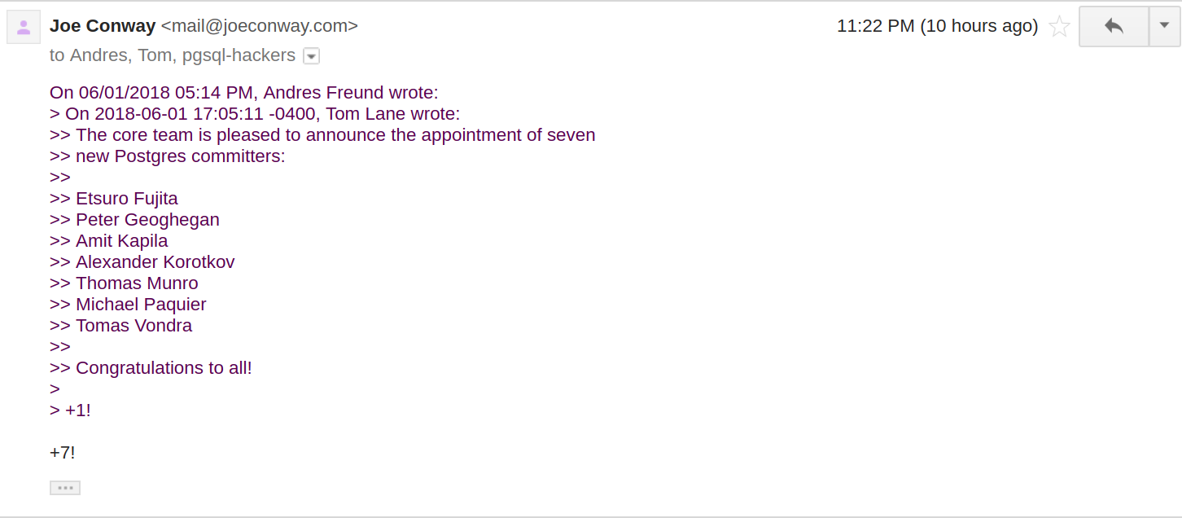
Committer Announcements

Slide 51
#5 Volunteer: Lead Project 1 / 2
Lead project
  Take responsibility
  Praise other contributors
  Acknowledge contributions
  Support towards their manager
  Provide tokens of appreciation

Slide 52
#5 Volunteer: Lead Project 2 / 2
Enable community career
  Define community career
  Define roles and positions
  Decide promotion privately
  Announce promotion clearly

Slide 53
Dealing with Difficult People 1 / 4 [CF08]
Understand the problem
  Difficult (“poisonous”) people
    May waste your time
    May split the project
    May ruin the project

Slide 54
Dealing with Difficult People 2 / 4
Prepare for the problem
  Build a healthy community
  Document all decisions

Slide 55
Dealing with Difficult People 3 / 4
Detect the problem
  Difficult people typically
    Don't show respect
    Behave clueless
    Are overly emotional
    Make sweeping claims

Slide 56
Dealing with Difficult People 4 / 4
Handle the problem
  Don't engage with difficult people
    Cf. “Don’t feed the troll”
  Ignore them if possible
  Boot them, if necessary

Slide 57
The Volunteering Process (Recap)
# | Volunteer View | Project View
1 | Find project | Market project
2 | Understand project | Explain project
3 | Engage with project | Engage with volunteer
4 | Work within project | Work with contributor
5 | Lead project | Enable career

Slide 58
Review / Summary of Session
Open source projects
Project roles and careers
The 3-4-5 model of open communities
  The three principles of open collaboration
  The four practices of open communication
  The five stages of open source volunteering

Slide 59
Thank you! Questions?
dirk.riehle@fau.de – http://osr.cs.fau.de
dirk@riehle.org – http://dirkriehle.com – @dirkriehle
DR

Slide 60
Credits and License
Original version
  © 2010-2019 Dirk Riehle, all rights reserved
Contributions
  Christoph Lindenmüller by email of 2011-09-01
  ...

